Slide 1

NeuroFleetX- AI-Driven Urban Mobility Optimization
Transforming Urban Transport
with Artificial Intelligence
Presentated by - Vaishnavi Ambhore

Slide 2
Introduction
NeuroFleetX is an intelligent, AI-based platform designed to transform urban mobility using real-time data and advanced analytics.
The system enhances transportation efficiency by providing smart traffic insights and dynamic route optimization.
It assists fleet operators and city authorities by predicting traffic congestion, automating fleet operations, and improving overall mobility management.
The goal is to create a safe, seamless, and environmentally sustainable transportation ecosystem for both commuters and urban communities.

Slide 3
Problem Statement
Rapid urban expansion has led to major challenges in city transportation systems.These include heavy traffic congestion, inefficient utilization of fleets,
unpredictable travel durations, and limited visibility into vehicle performance and
maintenance status.
In the absence of AI-driven intelligence, fleet operations often suffer from increased fuel consumption, service delays, higher maintenance costs, and reduced customer satisfaction.
These challenges emphasize the need for a unified smart mobility solution capable of optimizing routes, monitoring vehicle health in real time, automating booking processes, and improving overall operational efficiency.

Slide 4
Development Phase Overview
Backend API Development
01
02
This phase concentrated on establishing the fundamental system architecture, developing essential modules, and designing the initial user interface required for effective operation of the NeuroFleetX platform.
Robust RESTful APIs were developed to manage authentication, vehicle data, and booking operations.
Well-structured controllers, input validations, and secure communication mechanisms were implemented to ensure reliable data exchange across system modules.
Core Platform Setup
04
Primary UI & Dashboard Design
03
A complete full-stack environment was configured using React for the frontend, Spring Boot for backend services, and MySQL as the database.
Reusable UI components, application routing, and a scalable database schema were designed to support future system
Initial versions of key modules such as Dashboard, Vehicles, Bookings, and Maintenance pages were developed.
The UI was designed to be responsive and user-friendly, featuring a clean pastel-themed layout, smooth transitions, and intuitive navigation for an improved user experience.

Slide 5
Milestone 1
Milestone 2
Milestone 3
Milestone 4
Core Module Development
Feature Enhancements
Advanced Analytics Implementation
Foundation Setup
Acquired foundational knowledge in Java, React, and Spring Boot.
Built the initial login interface, practiced API development, and completed the project environment setup.
Developed role-based dashboards for Admin, Employee, and Customer users.
Added KPIs, charts, filters, data tables, and reusable UI components to enhance system functionality.
Enhanced the platform with live tracking improvements, booking validations, and refined UI/UX for better usability and system performance.
Successfully implemented authentication and integrated core modules such as Dashboard, Vehicles, and Bookings with backend services.

Slide 6



Tech Stack
Frontend
React,HTML,CSS,Tailwind/Bootstrap
Backend
Java ,Spring Boot for APIs
Database
MySql

Slide 7
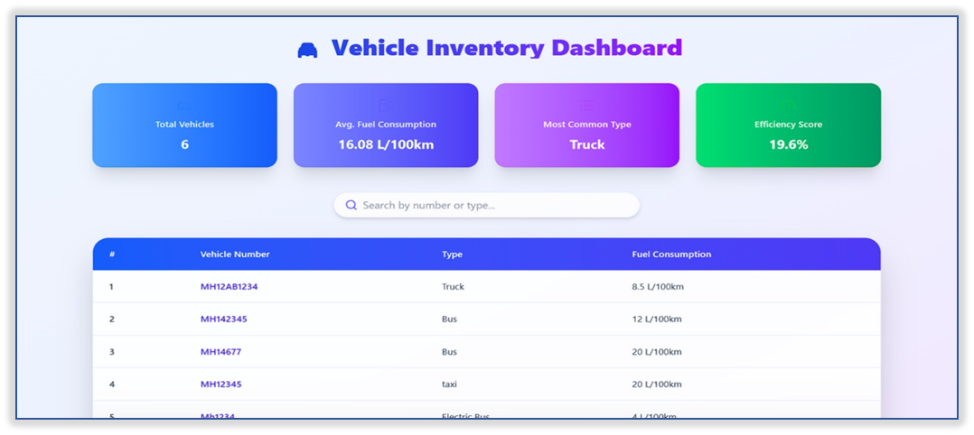
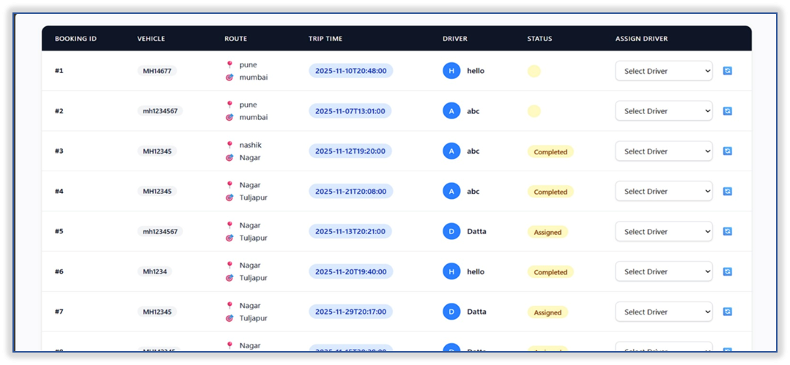
Admin Dashboard

Slide 8
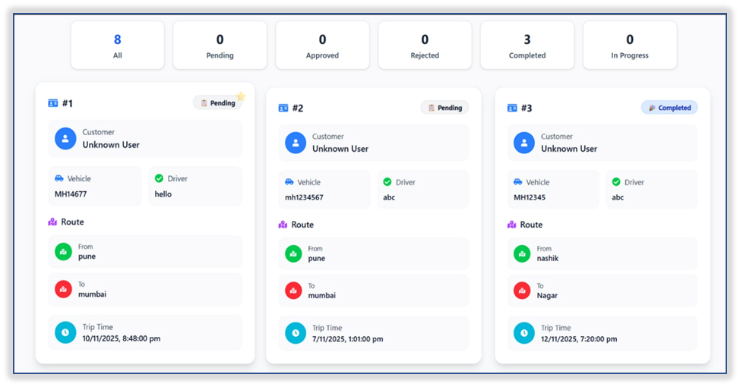
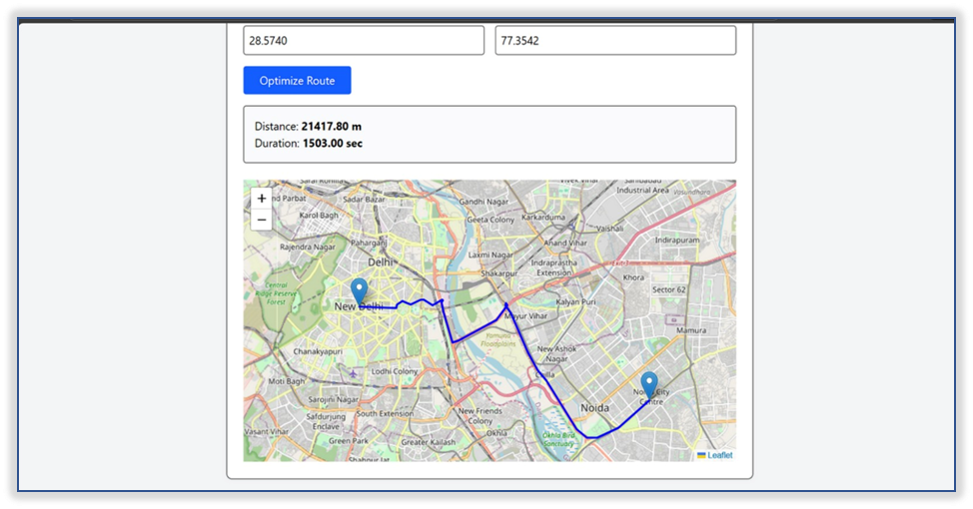
Customer Dashboard
Route Dashboard

Slide 9
Conclusion
NeuroFleetX represents a smart, scalable, and future-ready fleet management solution built on a strong technical foundation.
The platform integrates role-based dashboards, real-time tracking, predictive analytics, and intelligent booking systems to ensure efficient and reliable fleet operations.
Future development will focus on deeper AI integration, expanded data intelligence, enhanced automation, and improved user experience.
The long-term vision is to build a connected, sustainable, and high-performance urban mobility ecosystem through continuous innovation and intelligent technologies.

Slide 10
Thank you

